Slide 1


Mobile app “Fit for YOU” (for Android 4.0)
Виконала:
студ. групи ПІ-42
Andrushchakevych Olena

Slide 2
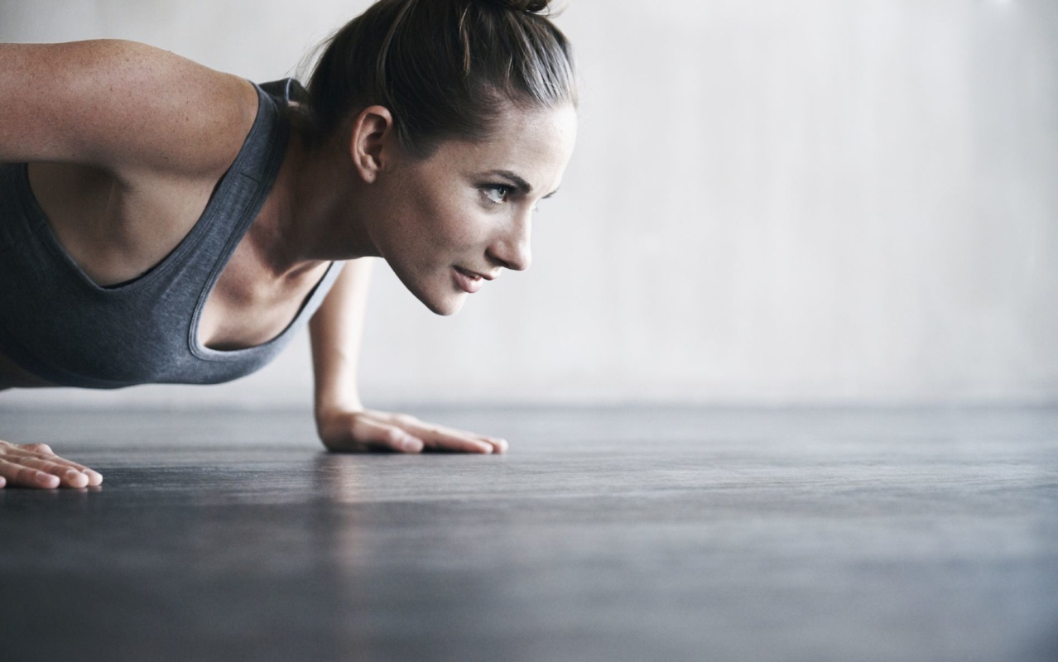
PROBLEM
Sport is getting more and more
popular today
But it is still hard to plan your training useful
and right with taking into account the technique of correct execution of exercises and their consistency

Slide 3

SOLUTION
This is a service that allows you to perform your sports training from the beginning to the end with taking into account your endurance and goals

Slide 4





KEY POSSIBILITIES
List of effective exercises
Calculation of calories per day
Time reminder workout
Activity calendar

Slide 5
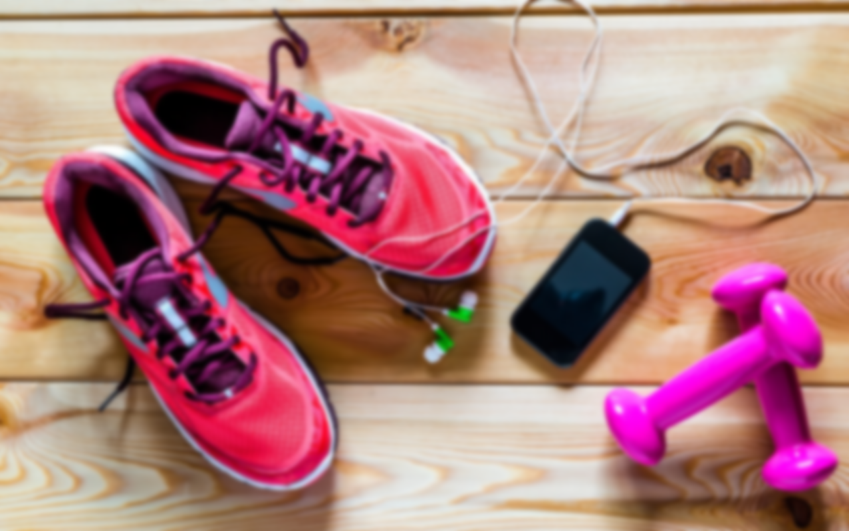
ANALOGS

Slide 6
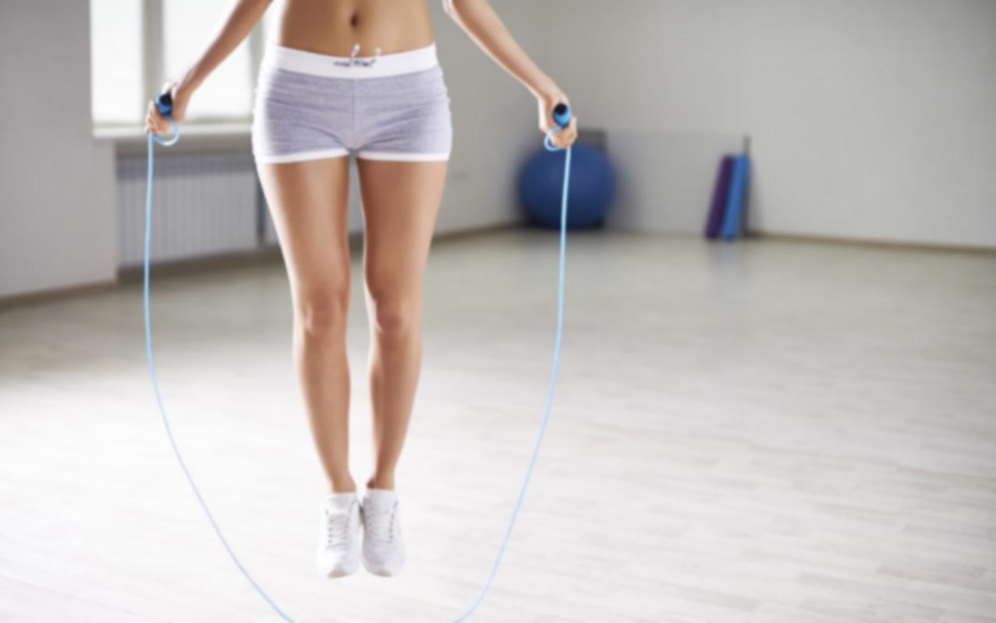
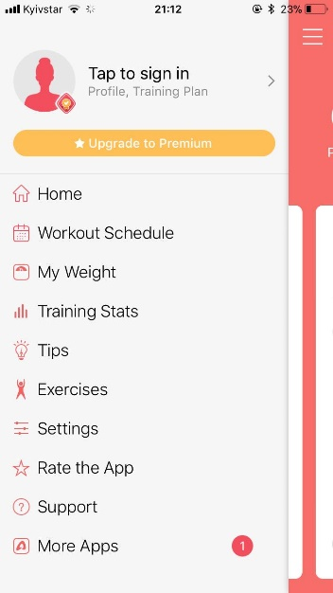

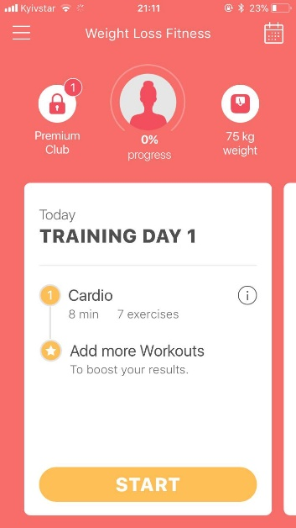
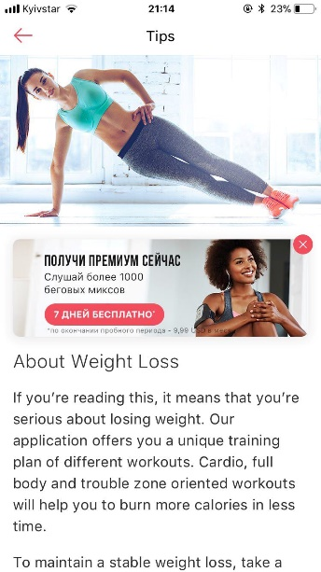
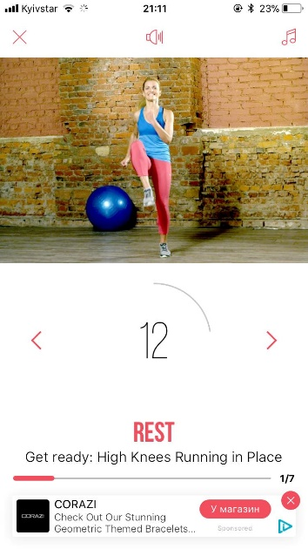
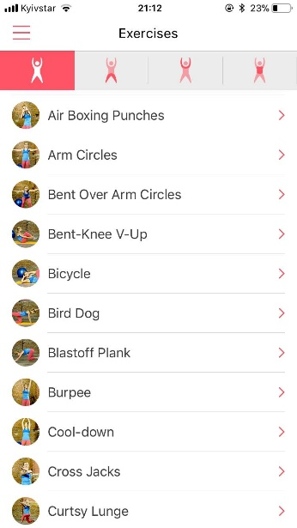

Weight
Loss Fitness
Advantages:
video and audio support
personal trainer
workout music
progress statistics
Disadvantages:
inconvenient in settings
advertising
1 571
Downloads: 100 000–500 000

Slide 7
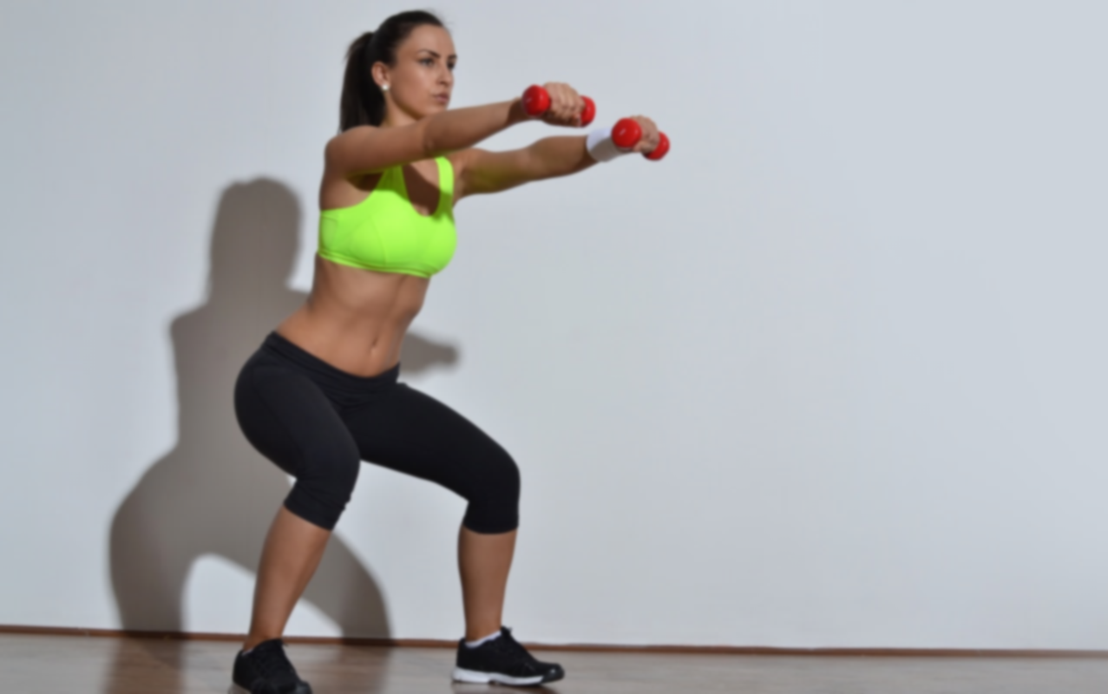
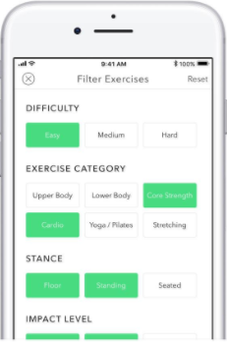

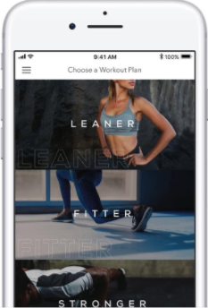
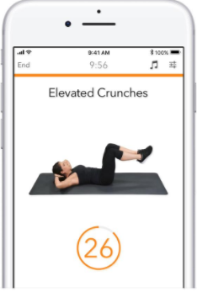
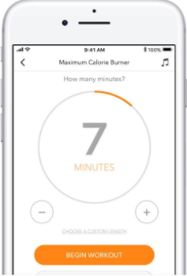
Sworkit
Advantages:
video and audio support
personal trainer
exercise for the office
animation workout
79 441
Disadvantages:
some exercises are
not displayed
Downloads: 5 000 000–10 000 000

Slide 8
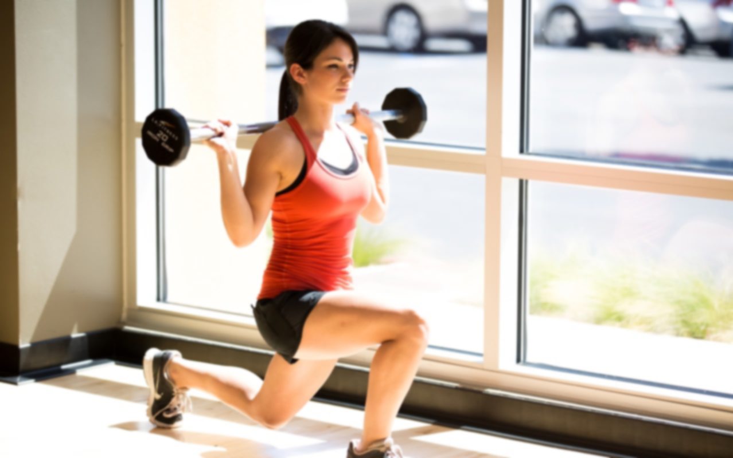

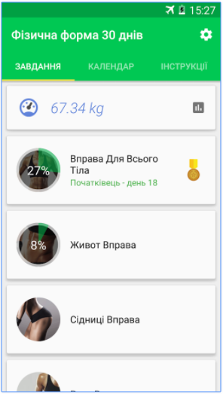
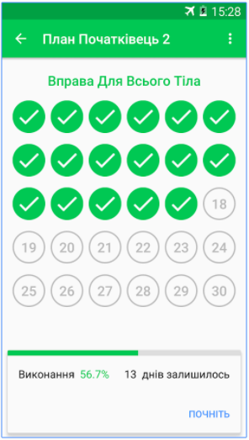
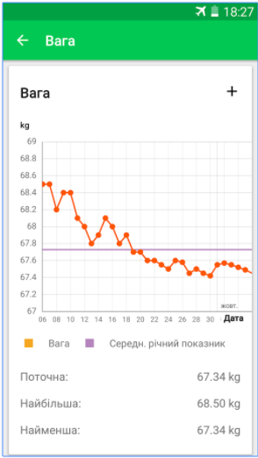
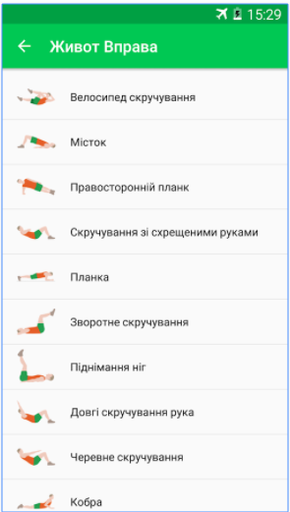
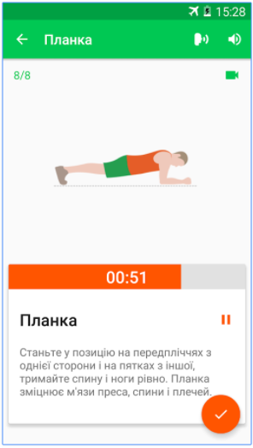
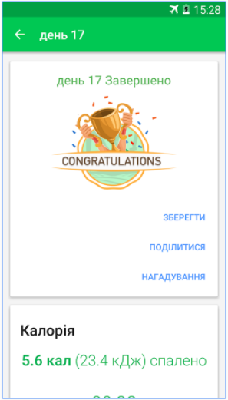
30 days
Advantages:
video and audio support
scheduling training
tracking progress
counting down the days
387 143
Disadvantages:
imperfect translation
no timer
Downloads: 10 000 000–50 000 000

Slide 9
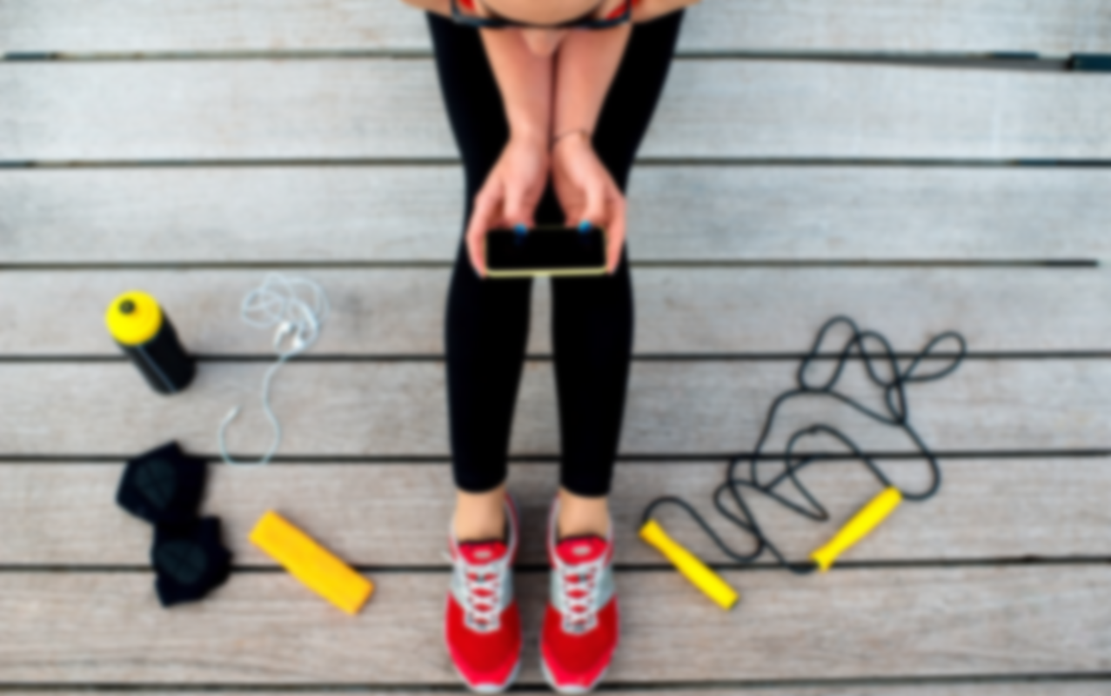


PERSON
Name: Maria
Age: 24
Home: Lviv, Ukraine
Personal characteristics:
friendly
leads a healthy way life
wants to lose weight
loves yoga

Slide 10
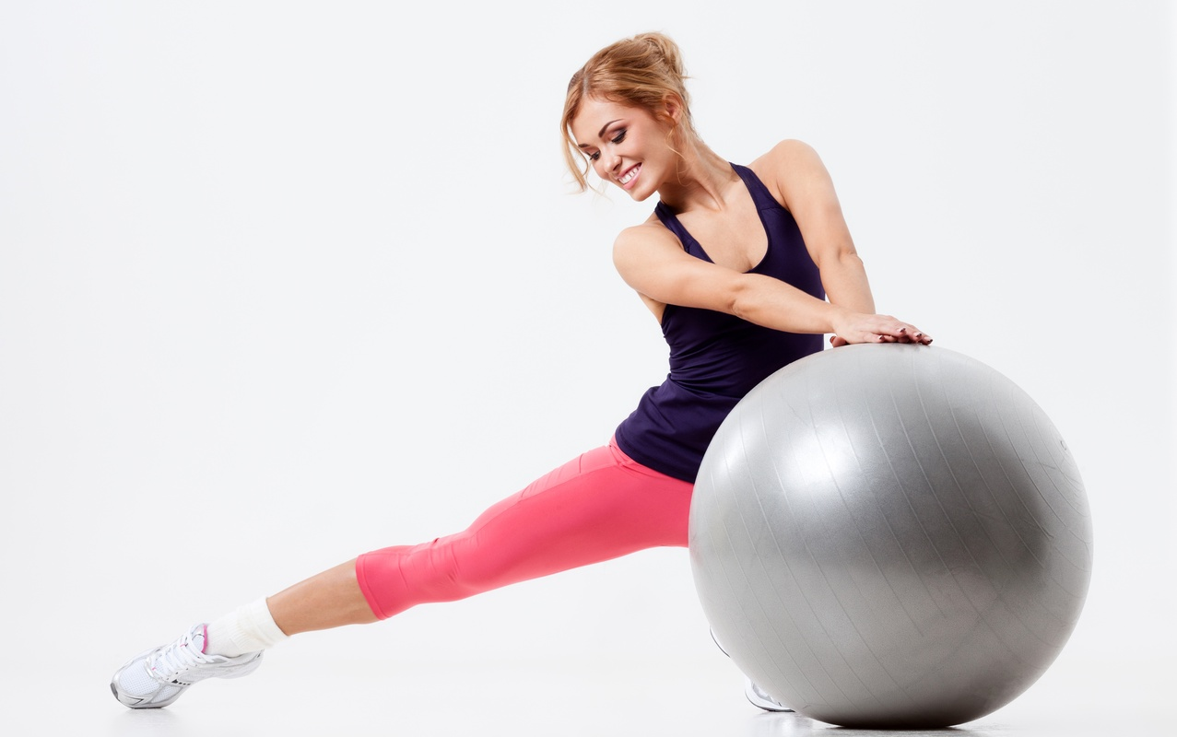
“Fit for YOU”
Circuit
switching
windows

Slide 11
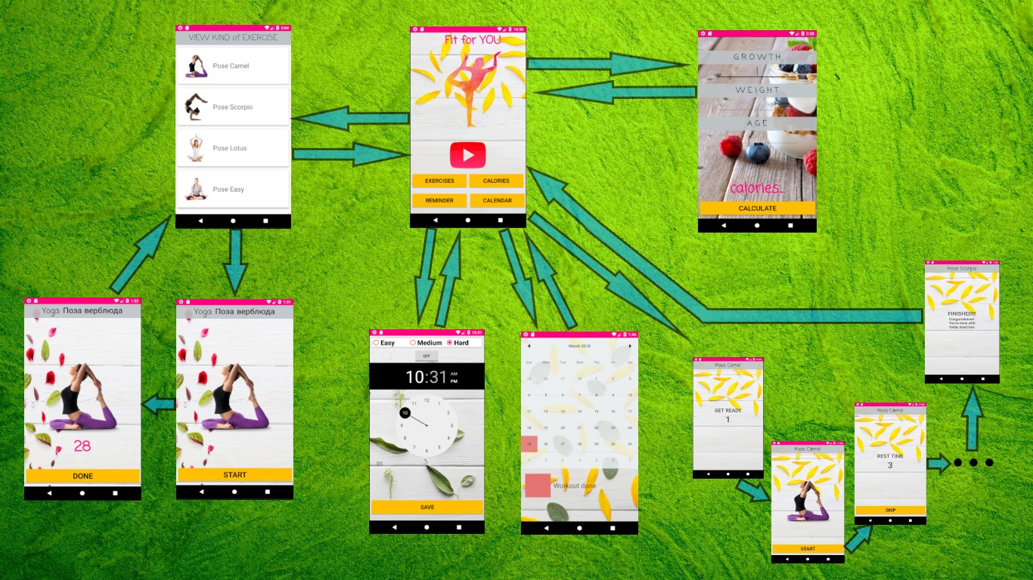

Slide 12

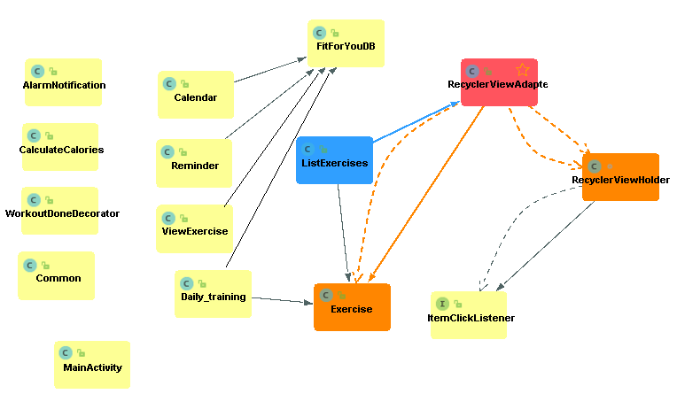
CLASS DIAGRAM

Slide 13
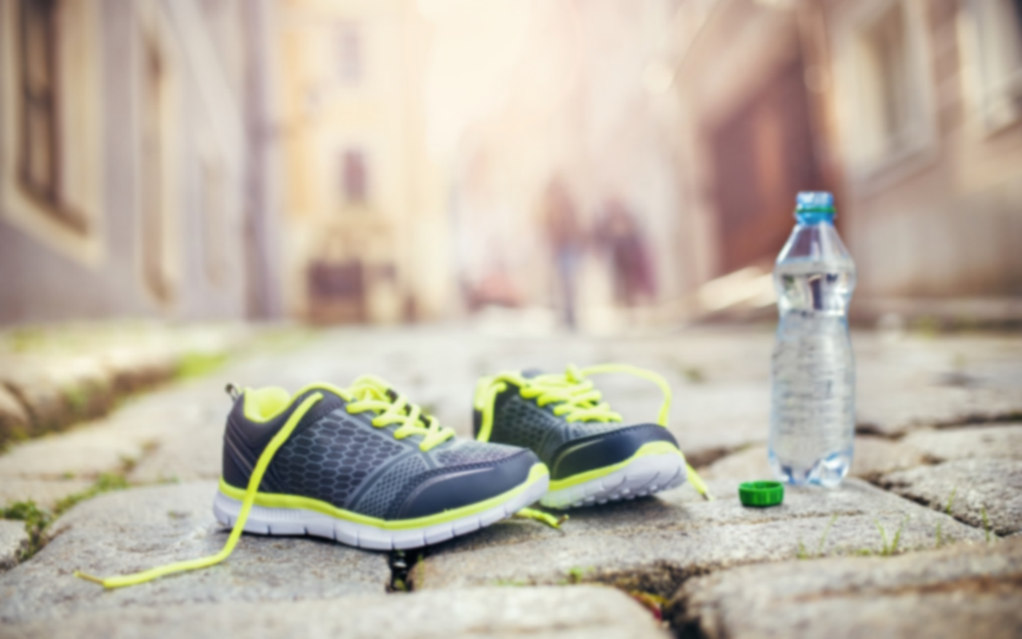
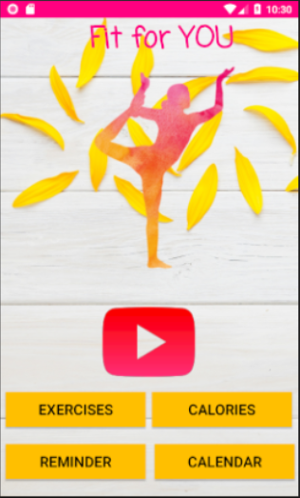
“Fit for YOU”
Using main menu you can:
see a list of all possible exercises
with yoga, aerobics and strength exercises;
calculate calories per day
put the alarm for training
adjust the difficulty level
view the activity calendar
execute complete daily workout

Slide 14

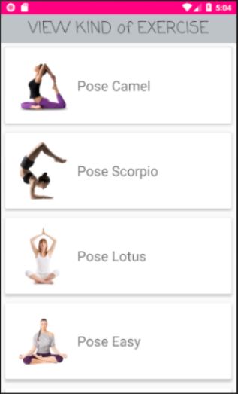
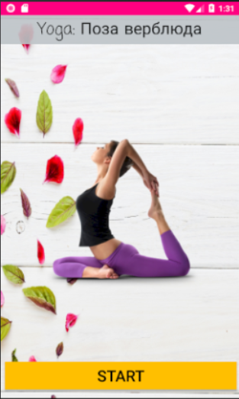
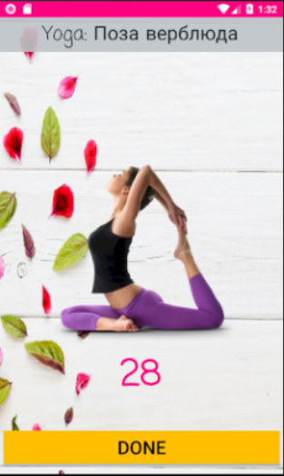
List of yoga exercises
Execution

Slide 15
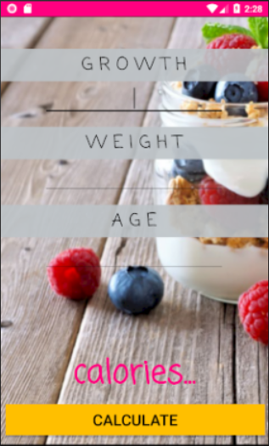
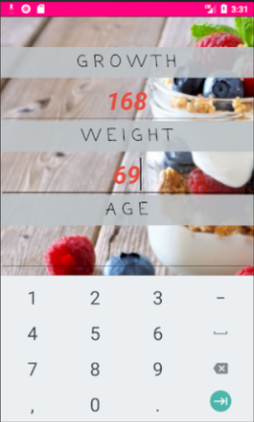
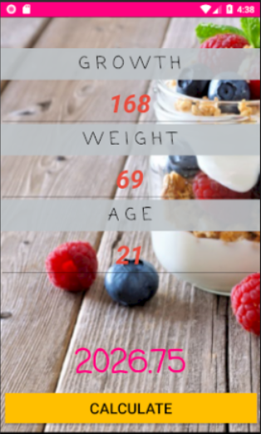
Calculate
calories
per day

Slide 16
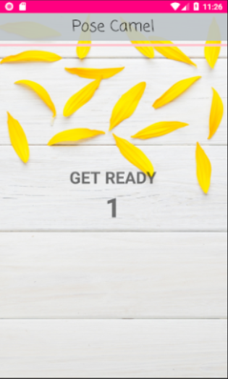
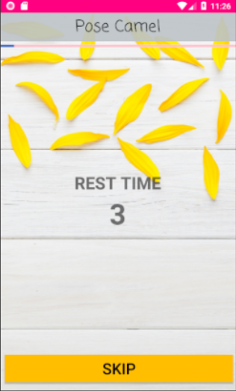
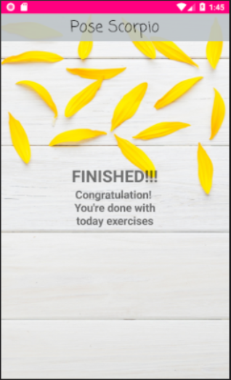
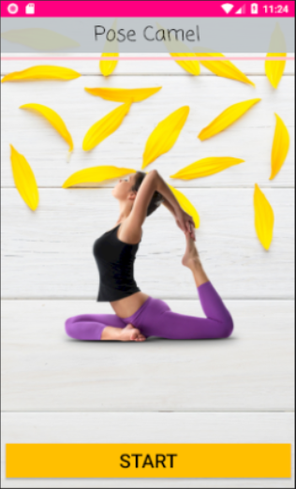
Perform a
complete
daily workout
of 15 exercises

Slide 17
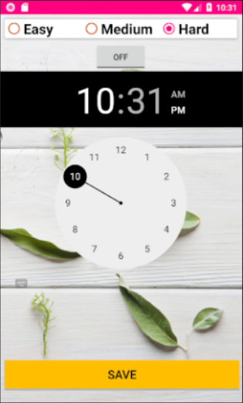
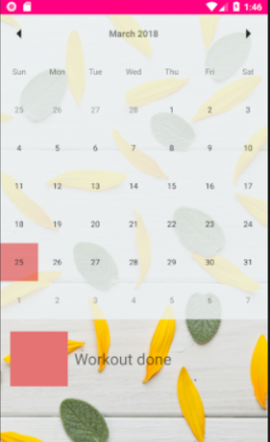
Alarm for workout
and
activity
calendar

Slide 18
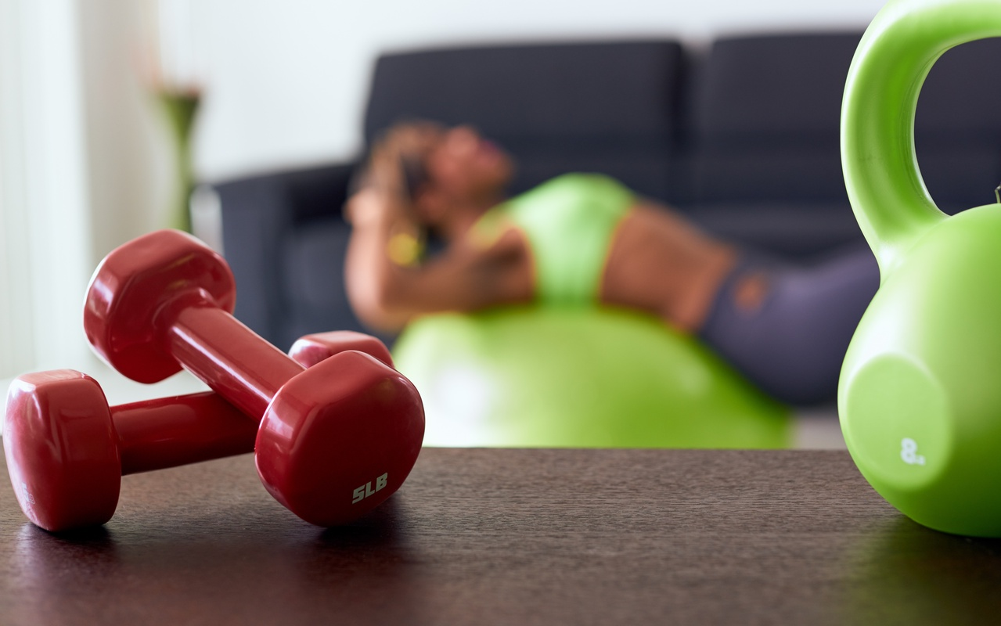
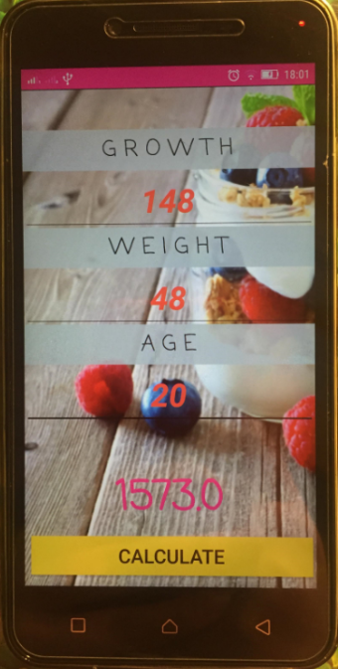
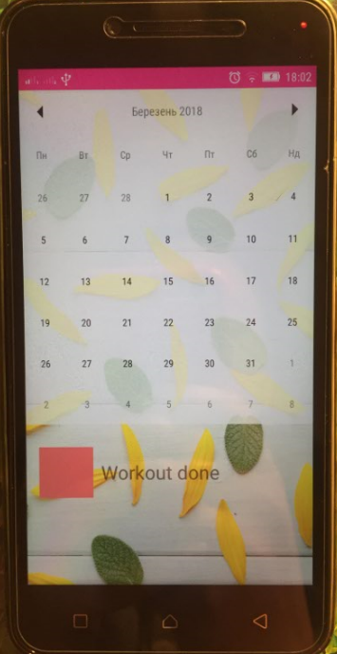
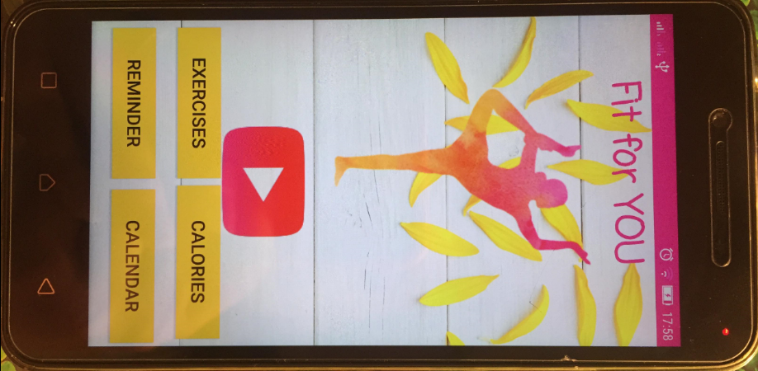
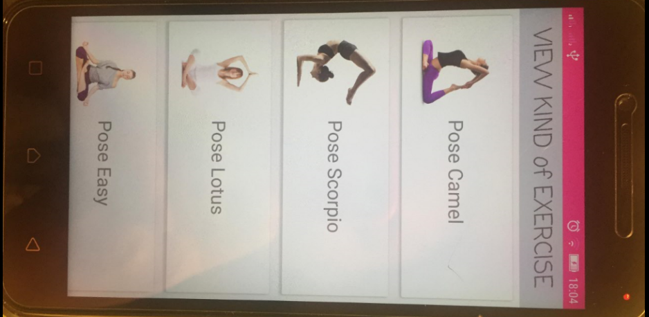
LOOKS on PHONE
Here you can see how the app looks on Lenovo A6020a46

Slide 19

Thanks for attention!

